Slide 1

BLOOD BANK MANAGEMENT SYSTEM
Presented by :
Ravi Kumar Gupta -23MCA1031
Pradhum Niroula – 23MCA1053
Submitted To :
Dr. Sandhya M
Professor
Vellore institute of Technology ,Chennai

Slide 2
INTRODUCTION
The blood bank management system project is like a test run. It helps the blood bank collect blood from different person and give it to people who really need it.
The software is designed to handle the daily transactions of the blood bank and search the details when required.
It also helps to register the details of donors, and hospitals and work as a bridge between donor and patients.
The software application is designed in such a manner that it can suit the needs of all the blood bank requirements in the course of future.

Slide 3
EXISTING SYSTEM
The operation of the blood bank still now is maintained in the manual system.
The operation is tedious, time consuming and space consuming.
It creates room for errors as the data is entered manually by the persons.
It includes the risk of the documents being lost over years and maintenance of the records is difficult.
The data recorded during testing or while acquiring the details of different aspects of blood bank management system is not so accurate and precise.

Slide 4
PROBLEM STATEMENT
Not having enough blood in an emergency.
People don't know much about donating blood and getting blood transfusions.
Deaths due to lack of blood during operations.
The Blood Bank Management System project aims to make all the procedures automated and therefore with computer system it can be more fast and accurate.

Slide 5
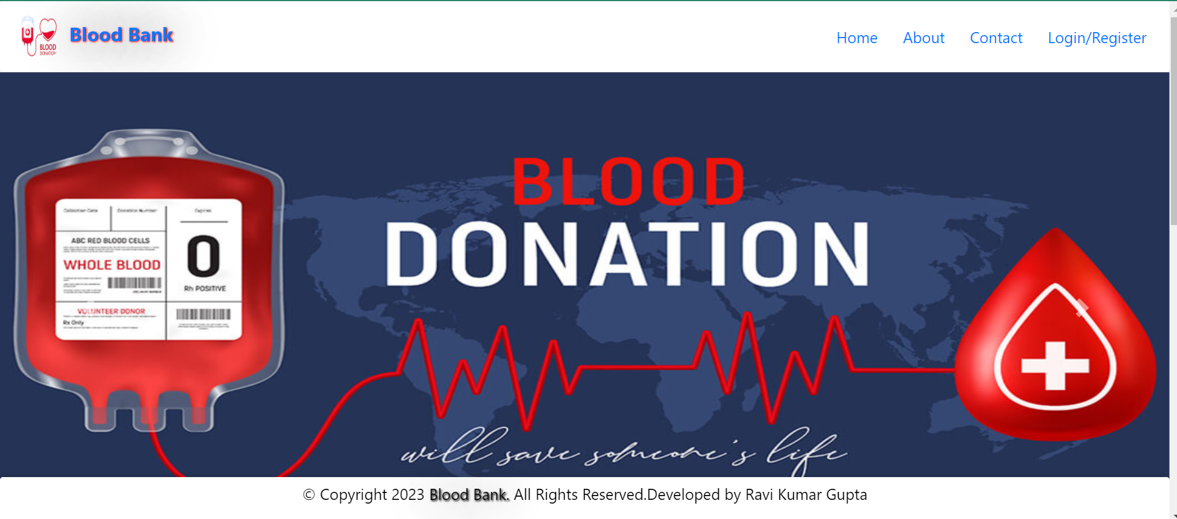
Home Page

Slide 6
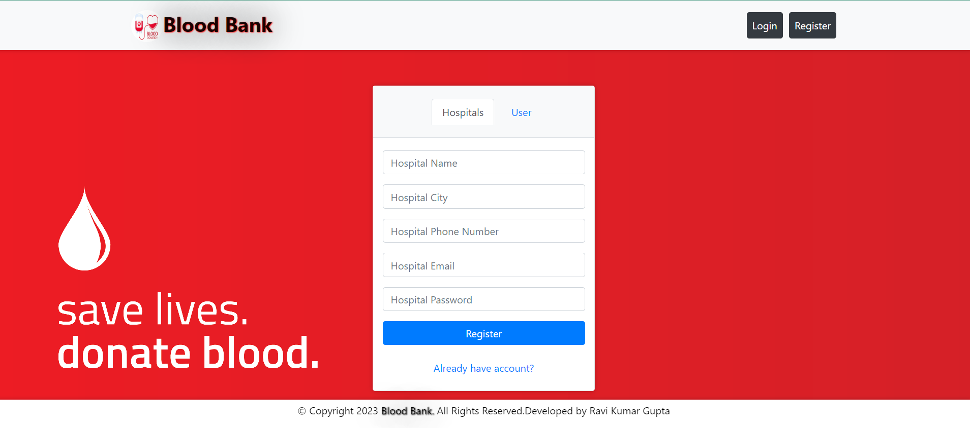
Registration/Login page

Slide 7

Hospital/Clinic Profile Page

Slide 8
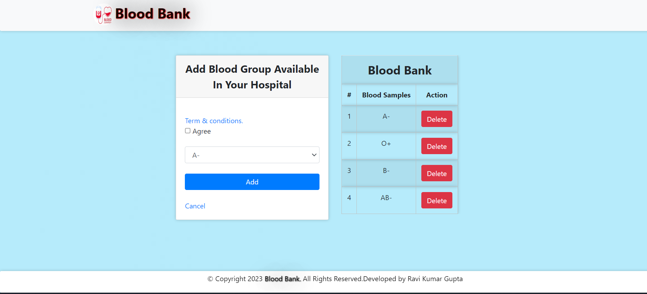
Hospital blood management Page

Slide 9
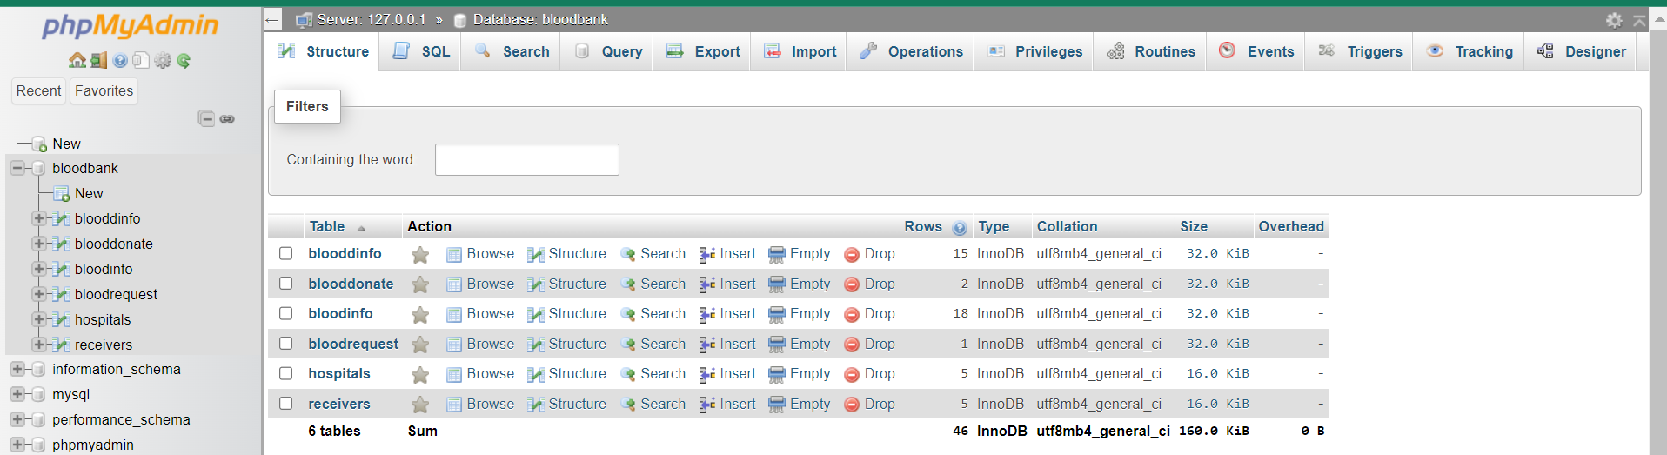
Database and tables

Slide 10
Thank You

